Slide 1
Funbid system design
Group 4:
- Lê Xuân Hưng
- Trần Tùng Dương
- Nguyễn Ngọc Quý

Slide 2
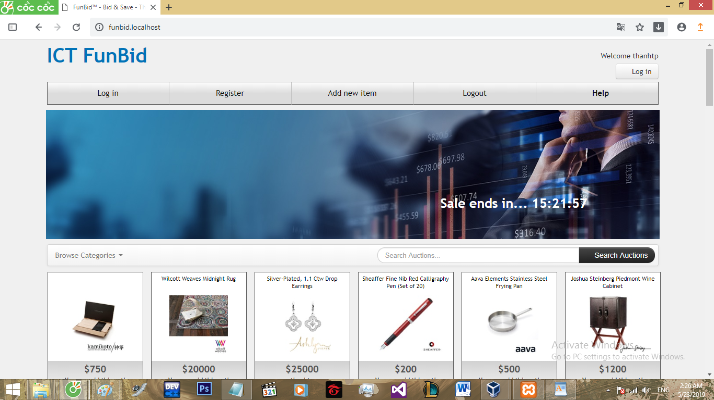
Introduction

Slide 3
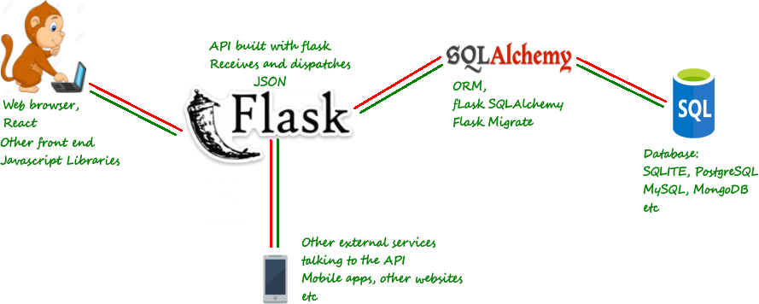
Architecture Design

Slide 4



Architecture Design
REST API using Python3 with flask and pyjwt
MySQL
HTML, CSS, React JS

Slide 5
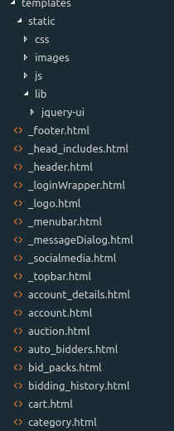
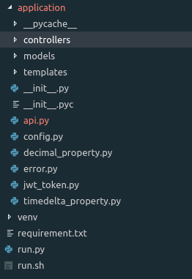
Project Structure

Slide 6
Thank you!

